Slide 1
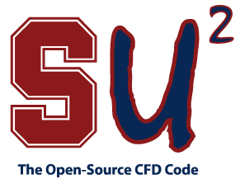
What is SU²?
The Stanford University Unstructured (SU²) is a software package for:
Fluid Simulation
and Engineering Design
SU² is distributed as Open-source software
SU² is under active development at Stanford University in the Aerospace Design Lab (ADL) of the Department of Aeronautics and Astronautics.
http://su2.stanford.edu/
SU² v3.0 (Eagle) will be released on Jan 11th, 2014

Slide 2
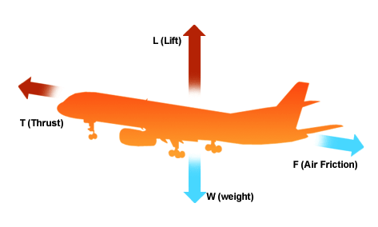
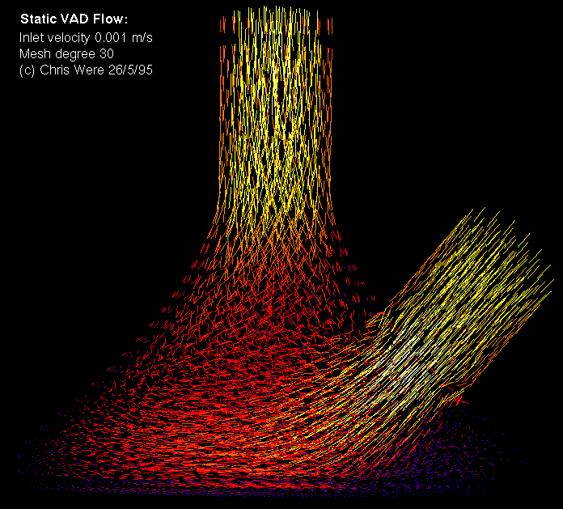
What is fluid simulation?
Fluids (liquids, gases) in motion exert forces on objects they come in contact with.
Forces are anything that pushes or pulls on systems.
Knowing the forces helps understand and design systems (airplanes, boats, cars, wind turbines, jet engines, pipe flow, blood/biological flow, ...)
http://www.bbc.co.uk/bitesize/standard/physics/images/plane.gif
http://homepages.engineering.auckland.ac.nz/~snor007/cfd/3d_vad-big.gif

Slide 3
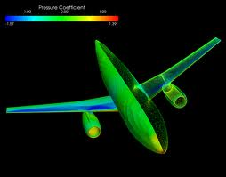
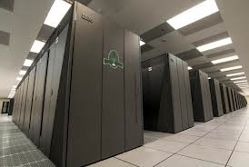
What is fluid simulation?
Newton’s laws describe the fluid motion with equations.
These equations of motion are, in most cases, too difficult to solve by hand.
Engineers use computers and computer algorithms to solve these equations of motions and compute the forces acting on an aircraft. This is called Computational Fluid Dynamics (CFD).
SU² is a highly advanced computational tool for fluid simulation.
http://news.stanford.edu/news/2012/january/images/aero_news.jpg
http://www.redorbit.com/media/uploads/2013/01/sequoia6_680_0-617x416.jpg

Slide 4
Engineering design
Knowing the forces helps to design engineering systems, e.g. reducing fuel consumption of aircraft
Experiments are expensive, intuition breaks down, and a simulation-based approach is necessary.
SU² has been specifically designed to solve engineering design problems.

Slide 5
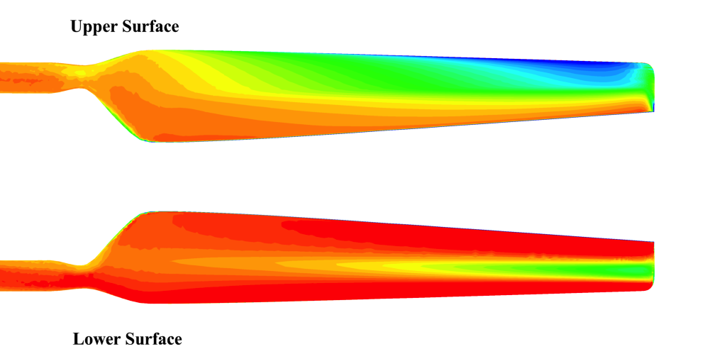
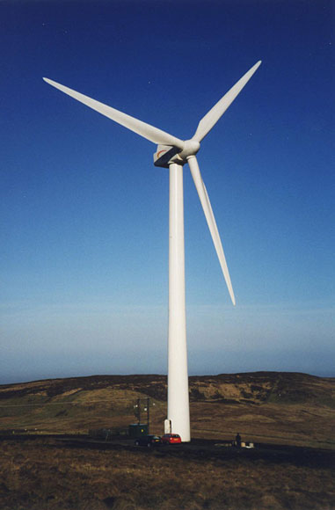
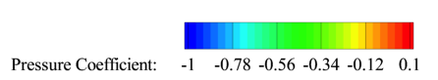
Application: Wind Energy
http://www.protectourcommunities.com/wp-content/uploads/2012/10/wind_turbine.jpg
Want more clean energy from wind, but…
Engineering challenges:
Large, complex hardware is expensive
Need aerodynamic efficiency, structural robustness
Uncertainties in design, variability in wind conditions
SU² aids in designing efficient, reliable wind turbines

Slide 6
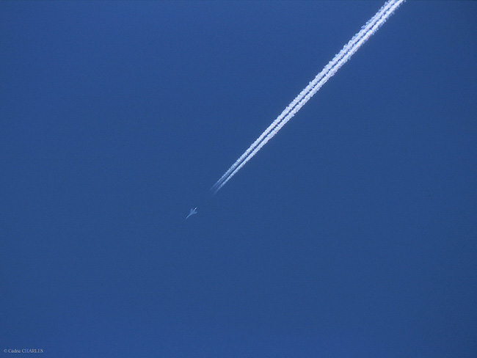
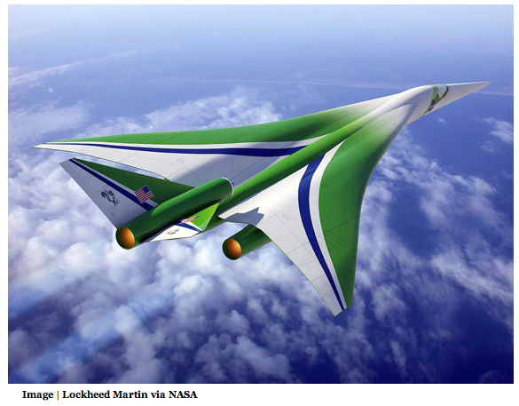

Application: Supersonic flight over land
Our ability to fly at supersonic speeds over land in civil aircraft depends on our ability to reduce the perceived loudness of the sonic boom
AF 4386 - Paris / Washington
June 12 th 2003
SU² is being used to design low-boom supersonic aircraft

Slide 7
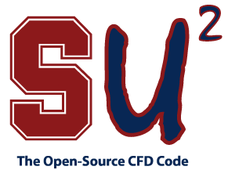
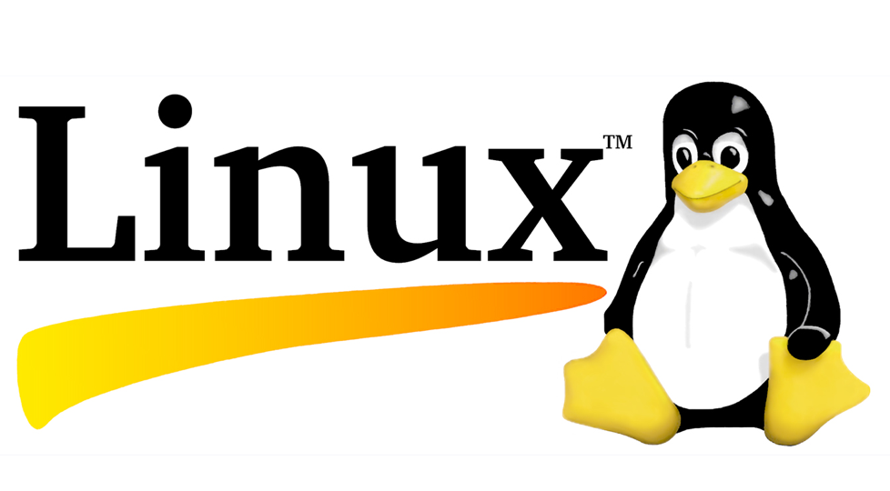



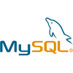


SU² as an open-source project
Computational analysis tools have revolutionized the way we design aerospace systems, but most established codes are proprietary, unavailable, or prohibitively expensive for many users.
The SU² team is changing this, making computational analysis and design freely available as open-source software and involving everyone in its creation and development.
Why?
Worldwide accessibility.
Encourage contributions from everyone.
Enables CFD research everywhere… the complexity of today’s problems requires tools to start from in order to make a technological impact.
Notes:
Why:
CFD Accessibility:
-- CFD technology is not new
-- Costs for commercial products O($10K) or more
-- Starting from scratch can be a major effort
-- Large companies (Boeing, Airbus, Lockheed, etc.)
-- Major Universities
-- Creates a culture of “have’s” and “have-not’s”
Open source levels the playing field and welcomes community input and requires sharing -- foster global technology advancement. Educational access whatever.
Community:
1) Rest of the community can contribute (global influence for software modification)
2) Online community to consult for help & support
3) Self-sustaining

Slide 8
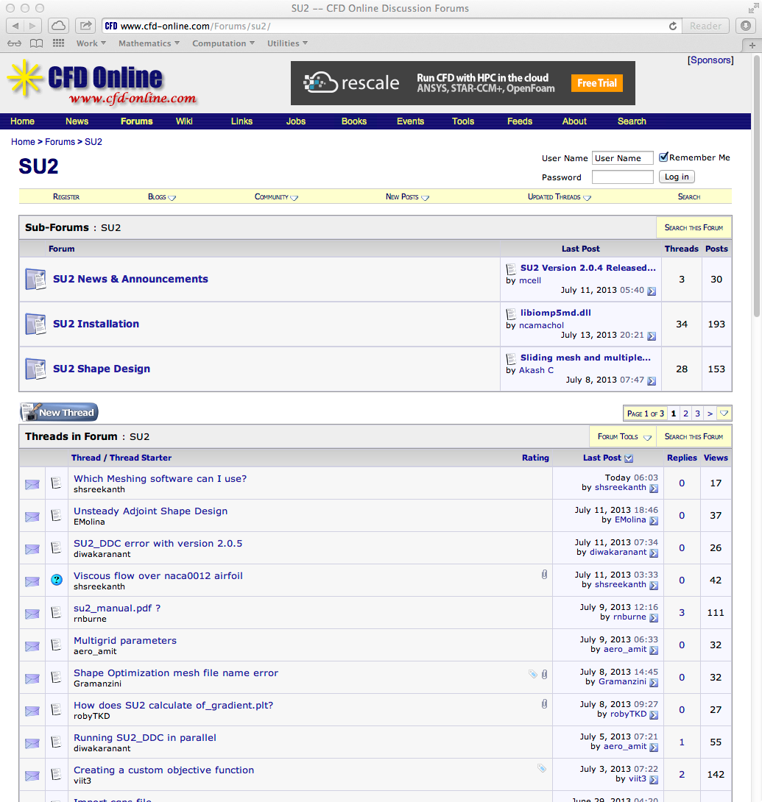
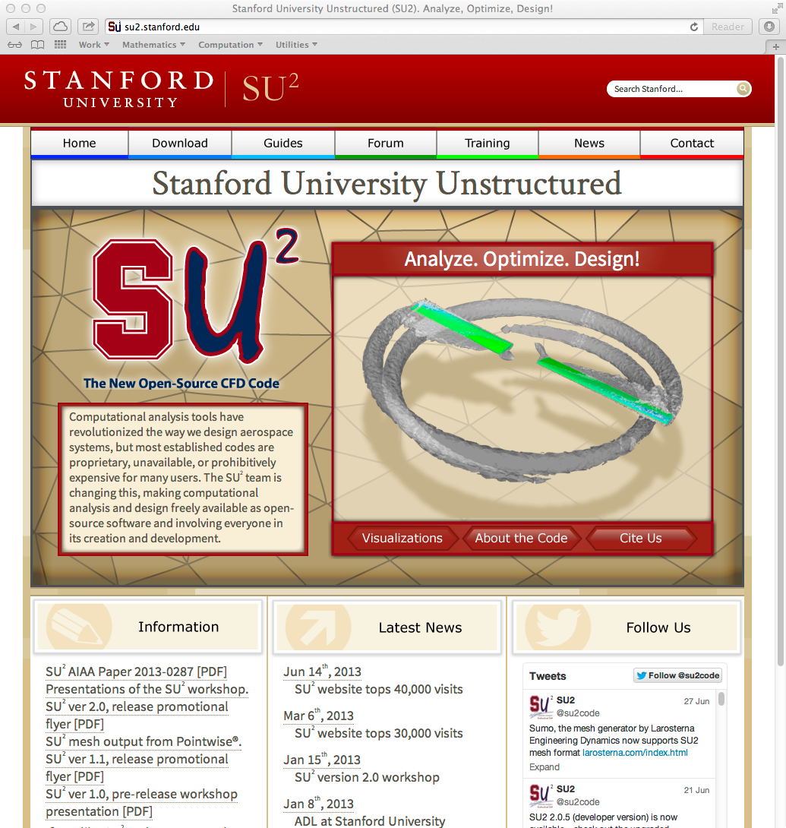
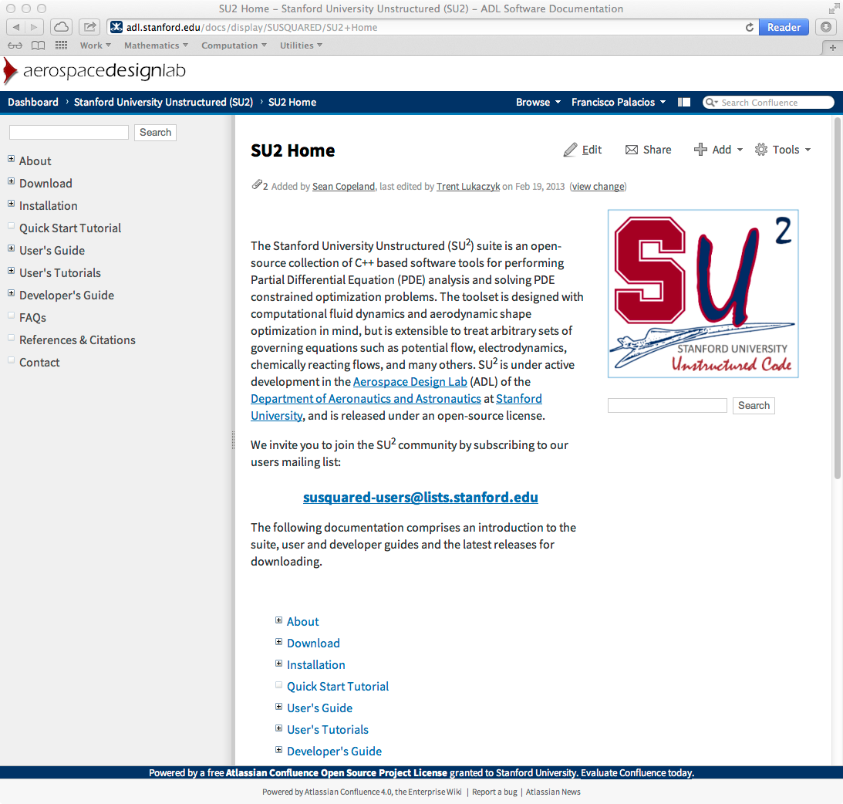
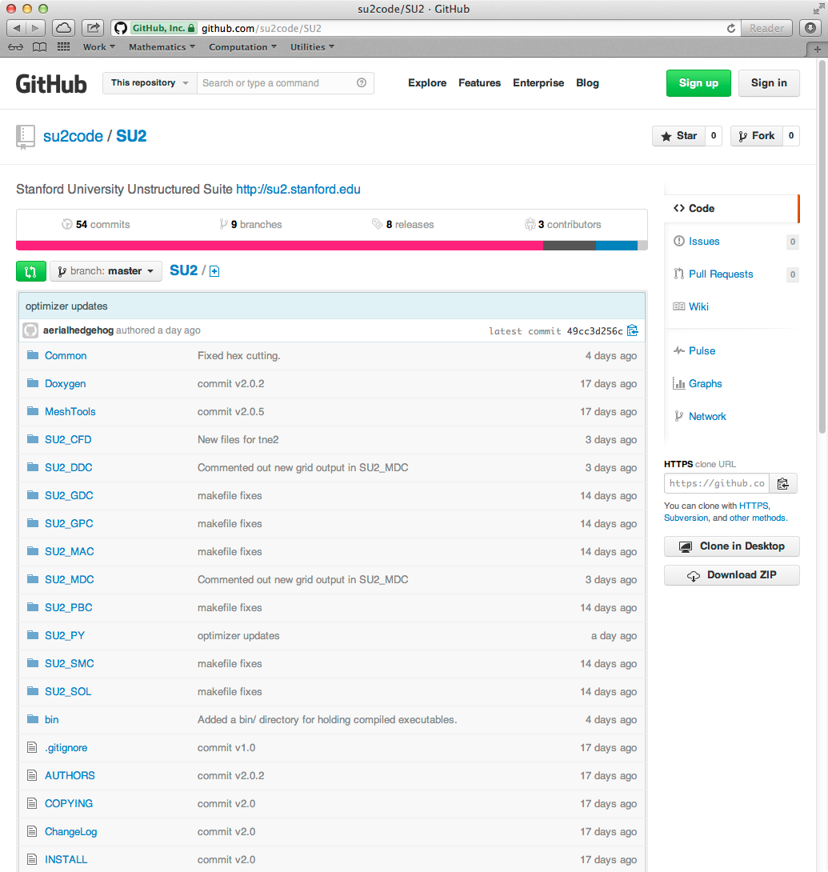
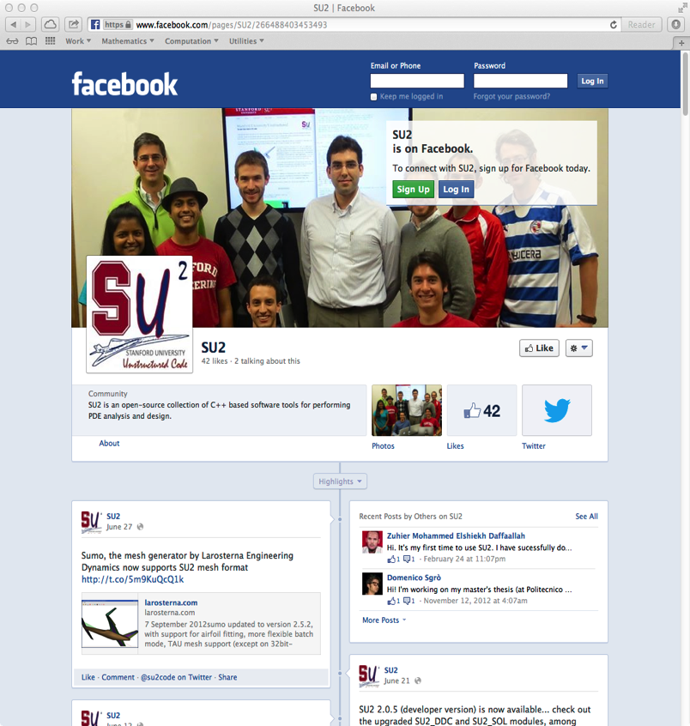
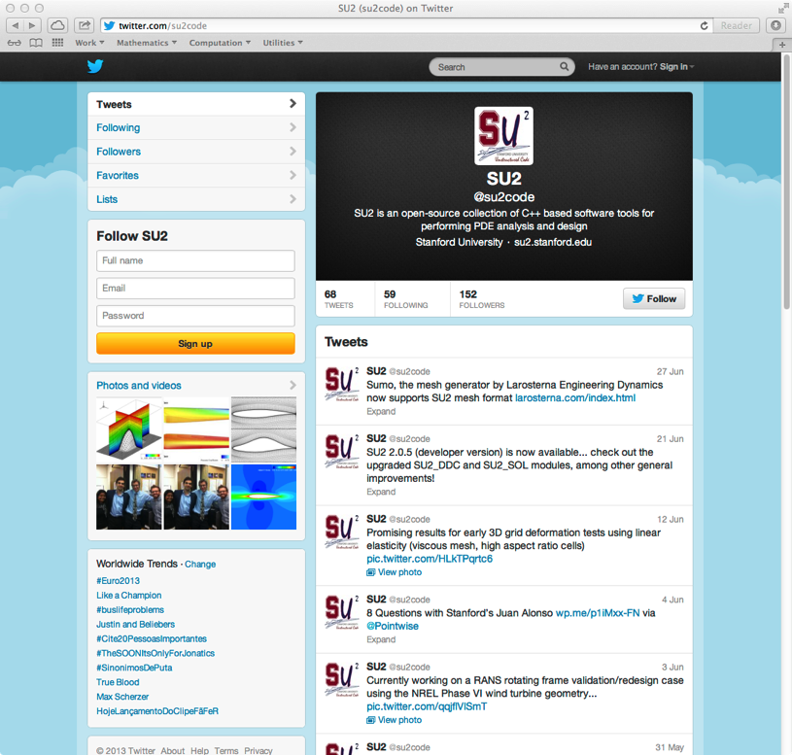
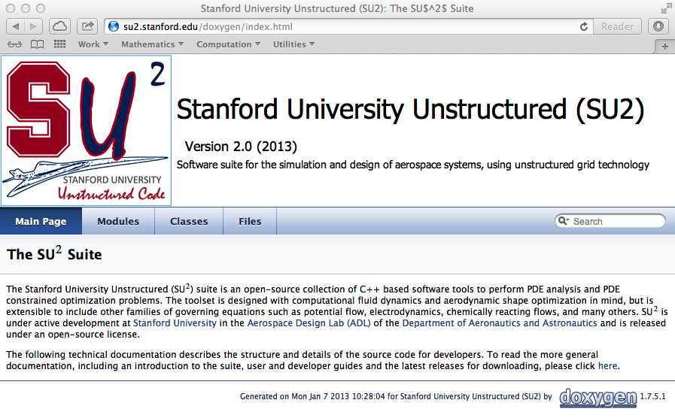
Open-source Community

Slide 9
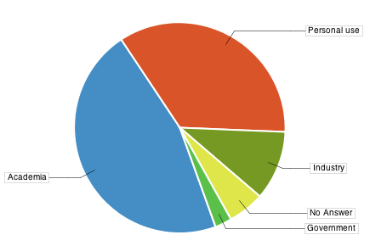
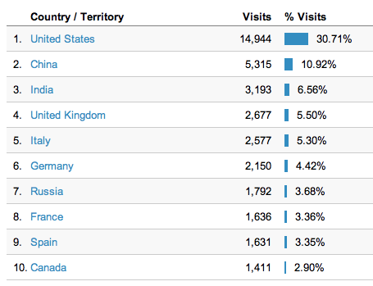
The first 20 months…
49,000 website visits from 136 countries
6,000 code downloads
Many top universities and aerospace companies

Slide 10
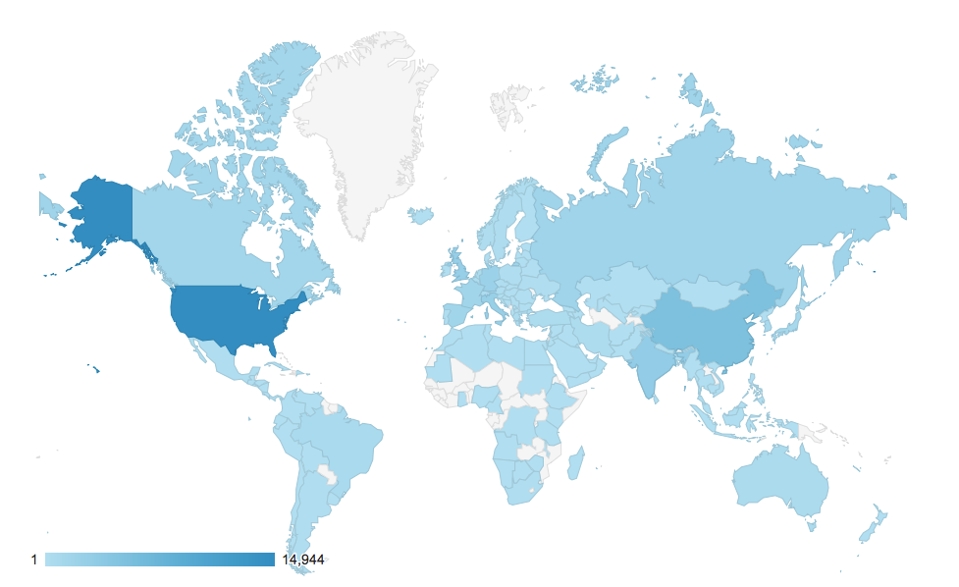
Global Reach
Website Visits

Slide 11

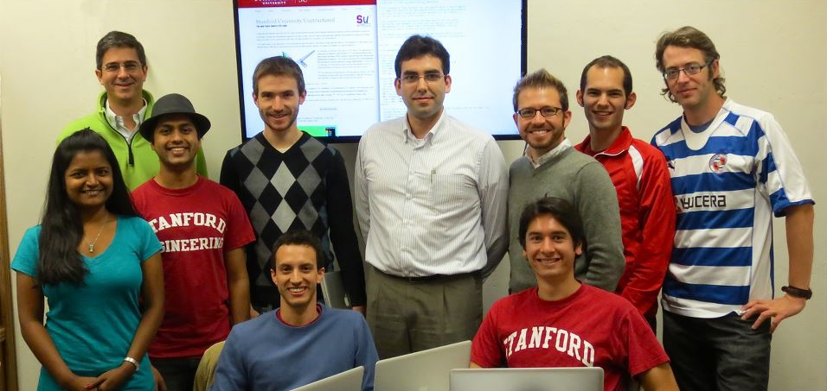

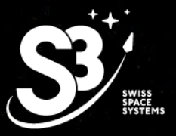
A Student-led Initiative
“Learning through building”
Two-way information exchange
Students equipped with expertise
Research & Industry interest

Slide 12
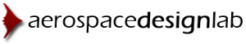


The SU² Team
Aniket C. Aranake, Alejandro Campos, Sean R. Copeland, Thomas D. Economon, Kedar R. Naik, Amrita K. Lonkar, Trent W. Lukaczyk, Santiago Padrón, Brendan D. Tracey
Ph.D. Candidates in the Aero/Astro department.
Francisco Palacios
Engineering Research Associate in the Aero/Astro department.
Lead Developer.
Michael R. Colonno
Engineering Research Associate in the Aero/Astro department.
Juan J. Alonso
Associate Professor in the Aero/Astro department.
Aerospace Design Laboratory (ADL) Director.
Supervision of the overall SU2 project.

Slide 13
Why is SU² important?
Cutting-edge research from Stanford available in real-time.
Enables advanced Computational Fluid Dynamics research in places that don’t have the resources or expertise.
Making the state-of-the-art in computational fluid dynamics freely availability will help companies create faster and greener aircraft, cars, boats, etc.
Perfect tool for facing some of the future challenges for aviation: achieving supersonic flight over land, and reducing fuel burn, emissions, and noise.

